Slide 1
Core Concerns
Business Logic
Log, security, transaction
Cross cutting concerns
Messaging, mail support, DB access,
plumbing

Slide 2
Types of EJB 3.1
Session Beans
Message Beans
Stateless Session Bean
Stateful Session Bean
( No pool )
Singleton Session Bean
JPA

Slide 3
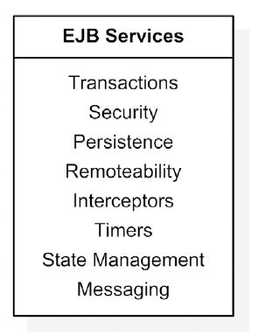
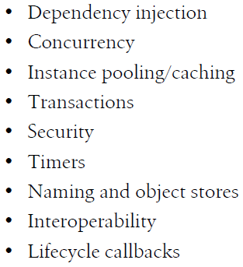
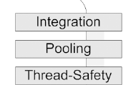
To see description of these service see
Page no 53 in “EJB in action”
Stateful Session bean

Slide 5
Easy for unit testing
New Features of EJB 3.1
Free from XML configuration
Annotation
Metadata Programming
Free from JNDI lookup
Dependence Injection
No interface
Asynchronous
Aspect-J like interceptors
Persistence Provider

Slide 6
Session Bean Client
Local interface
Remote interface
Web service
(stateless only)
EJB Reference obtained in client
@EJB annotation( prefered )
JNDI Lookup
EJB Context

Slide 7
EJB Context
This object used to access EJB Container and its configuration.

Slide 8
EJB Transaction
( it use JTA )
Declarative
(CMT) ( JTA used behind the scene)
Programatic
(BMT)
Deployment Decriptor
annotation
developer use JTA API directly

Slide 9
